Slide 1
University physics, classical mechanics, Lecture 9. Still Lesson 7: Rotation of rigid bodies
Teacher: Dr. Paul Briard
Wechat: Paulbg123

Slide 2





Reminder of the previous lecture
$$\vec{F}$$
Force exerted on the body
O +
$$\vec{r}$$
$$+$$
$$P$$
A rigid body
Point of application of the force on the body (important to study the torque !)
The net torque exerted on a body in rotation around an axis, about a point (here the point O) of this axis, is:
$$\vec{τ}=\vec{r}×\vec{F}$$
Notes:
PARLER LENTEMENT: To begin, here I remind you the key-points discussed the last time. First, we have described what is the torque exerted by a force about a point, the point O in this figure. It is the vector production between the position vector r, and the force F. Take care that we must say always about which point we describe a torque because the torque depends to which point is chosen. Usually, we will describe the torque about a point of the axis of rotation of the body in rotational motion. As you see also, the torque depends to which point of application of the force exerted on the rigid body we consider. The torque describe how the force participate or not on the rotational motion of the body, and is related with its rotational motion.

Slide 3

Reminder of the previous lecture
The net torque exerted on a body in rotation around an axis, about a point of this axis, is:
$$\vec{τ}=I\vec{α}$$
Moment of inertia (about this axis)
Angular acceleration vector
Notes:
PARLER LENTEMENT: Here is the rotational analogy of the Newton second law. The net torque about a point of the axis of rotation exerted on a rigid body is the product between the moment of inertia of the body about this axis of rotation and the angular acceleration vector of the rigid body. Thus, if you know the net torque exerted, you know its angular acceleration, and you can describe its rotational motion.

Slide 4

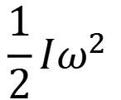
Reminder of the previous lecture
The net torque exerted on a body in rotation around an axis, about a point of this axis, is:
$$\vec{τ}=I\vec{α}$$
Moment of inertia (about this axis)
Angular acceleration vector
Rotational kinetic energy :
$$\frac{1}{2}Iω^{2}$$
$I$: Moment of inertia about the axis of rotation.
$ω$: angular velocity (magnitude of the angular velocity vector $\vec{ω}$)
Notes:
PARLER LENTEMENT: We have also described what the rotational kinetic energy, which is similar to the translational kinetic energy. The rotational kinetic energy of a body in rotation is the half of the moment of inertia of the body about the axis of rotation, multiplied by the square of the angular velocity omega.

Slide 5
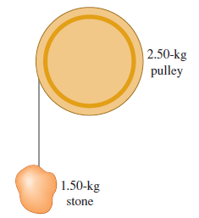




Ex. Energy considerations in a system pulley +stone
$$z$$
The potential energy of the stone is chosen to be zero when the stone is released.
$$z=0$$
$$h$$
$$z=−h$$
A frictionless pulley has the shape of a uniform solid disk of mass 2.50 kg and radius 20.0 cm. A 1.50-kg stone is attached to a very light wire that is wrapped around the rim of the pulley, and the system is released from rest. How far must the stone fall so that the pulley has 4.50 J of kinetic energy? Friction is ignored.
Moment of inertia of disk of mass $M_{P}$ and radius R about its axis is:
$$I=\frac{1}{2}M_{p}R^{2}$$
Notes:
PARLER LENTEMENT: Here is a little exercise where potential energy is involved. A stone is connect to a wire and then a frictionless pulley which is a solid disk. Of course, the pulley is fixed to the wall and the only motion in this problem are the translational motion of the stone and the wire and the rotational motion of the pulley. The stone is released from rest and then moves downward due to the effect of the gravity. Please to describe how far the stone fall so the pulley has the kinetic energy which the value is 4.50 joules. The pulley has only rotational motion. I give you also the expression of the moment of inertia of a disk about its axis. Friction is ignored which means there is conservation of the mechanical energy.

Slide 6

Ex. Energy considerations in a system pulley +stone
The rotational kinetic energy of the pulley is:
$$E_{K,pulley}=\frac{1}{2}Iω^{2}$$
Notes:
PARLER LENTEMENT: The pulley has no translational motion, so its kinetic energy is described as follows where omega is the angular velocity and I is the moment of inertia about the axis of rotation of the pulley, which is also the axis of this pulley

Slide 7

Ex. Energy considerations in a system pulley +stone
The rotational kinetic energy of the pulley is:
$$E_{K,pulley}=\frac{1}{2}Iω^{2}$$
where $I$ is the moment of inertia of the pulley about its axis of rotation:
$$I=\frac{1}{2}M_{p}R^{2}=0.0500 kg.m^{2}$$
Notes:
PARLER LENTEMENT: By using the expression of the moment of inertia, we can calculate its value.

Slide 8

Ex. Energy considerations in a system pulley +stone
The rotational kinetic energy of the pulley is:
$$E_{K,pulley}=\frac{1}{2}Iω^{2}$$
where $I$ is the moment of inertia of the pulley about its axis of rotation:
$$I=\frac{1}{2}M_{p}R^{2}=0.0500 kg.m^{2}$$
We obtain the angular velocity corresponding to a rotational kinetic energy of 4.50 J :
$$ω=\sqrt{2E_{K,pulley}/I}=13.4 rad.s^{−1}$$
Notes:
PARLER LENTEMENT: When the pulley has kinetic energy of 4.50 Joules, it has a certain angular velocity we can describe from the expression of its kinetic energy. The angular velocity is 13.4 radians per second.

Slide 9

Ex. Energy considerations in a system pulley +stone
The rotational kinetic energy of the pulley is:
$$E_{K,pulley}=\frac{1}{2}Iω^{2}$$
where $I$ is the moment of inertia of the pulley about its axis of rotation:
$$I=\frac{1}{2}M_{p}R^{2}=0.0500 kg.m^{2}$$
We obtain the angular velocity corresponding to a rotational kinetic energy of 4.50 J :
$$ω=\sqrt{2E_{K,pulley}/I}=13.4 rad.s^{−1}$$
The corresponding velocity for the stone (or a point of the pulley at distance R from the center) is
$$v=Rω=2.68 m.s^{−1}$$
Notes:
PARLER LENTEMENT: And we can describe the velocity of the stone corresponding to the angular velocity omega. It is the same velocity than the velocity of a point at distance R from the center of the pulley, because of the string which connect the pulley of the stone.

Slide 10

Ex. Energy considerations in a system pulley +stone
The rotational kinetic energy of the pulley is:
$$E_{K,pulley}=\frac{1}{2}Iω^{2}$$
where $I$ is the moment of inertia of the pulley about its axis of rotation:
$$I=\frac{1}{2}M_{p}R^{2}=0.0500 kg.m^{2}$$
We obtain the angular velocity corresponding to a rotational kinetic energy of 4.50 J :
$$ω=\sqrt{2E_{K,pulley}/I}=13.4 rad.s^{−1}$$
The corresponding velocity for the stone (or a point of the pulley at distance R from the center) is
$$v=Rω=2.68 m.s^{−1}$$
At this velocity, the stone has translational kinetic energy
$$E_{K,Stone}=\frac{1}{2}m_{S}v^{2}=5.39 J$$
Notes:
PARLER LENTEMENT: Thus, we can describe the corresponding kinetic energy of the stone. The stone has no rotational motion. It has only a translational motion.

Slide 11
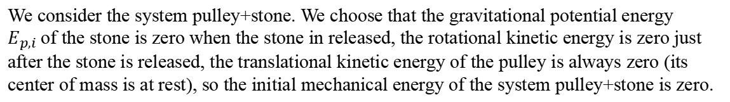
Ex. Energy considerations in a system pulley +stone
We consider the system pulley+stone. We choose that the gravitational potential energy $E_{p,i}$of the stone is zero when the stone in released, the rotational kinetic energy is zero just after the stone is released, the translational kinetic energy of the pulley is always zero (its center of mass is at rest), so the initial mechanical energy of the system pulley+stone is zero.
Notes:
PARLER LENTEMENT: We consider the system pulley+stone. The friction is ignored, so there is conservation of its mechanical energy. The gravitational potential energy is chosen to be zero when the stone is released, What is important is how change the potential energy, we can choose any position as a position of zero gravitational potential energy. Just after the stone is released, the rotational kinetic energy is zero, and then increase because its angular velocity increase. The translational kinetic energy of the pulley is always zero because the pulley has no translational motion. So, when the stone is released the mechanical energy of the system pulley+stone is zero and stays zero because the friction is ignored.

Slide 12

Ex. Energy considerations in a system pulley +stone
We consider the system pulley+stone. We choose that the gravitational potential energy $E_{p,i}$of the stone is zero when the stone in released, the rotational kinetic energy is zero just after the stone is released, the translational kinetic energy of the pulley is always zero (its center of mass is at rest), so the initial mechanical energy of the system pulley+stone is zero.
The friction is ignored, so all the forces exerted during the motion, i.e. the gravitational force on the stone are conservative), the total mechanical energy of the system is conserved.
$$E_{k,i}+E_{p,i}=E_{k,f}+E_{p,f}$$
Notes:
PARLER LENTEMENT: The conservation of the mechanical energy is described as follows, the initial mechanical energy is equal to the final mechanical energy. The only forces exerted on the system are the gravitational force which is conservative.

Slide 13

Ex. Energy considerations in a system pulley +stone
We consider the system pulley+stone. We choose that the gravitational potential energy $E_{p,i}$of the stone is zero when the stone in released, the rotational kinetic energy is zero just after the stone is released, the translational kinetic energy of the pulley is always zero (its center of mass is at rest), so the initial mechanical energy of the system pulley+stone is zero.
The friction is ignored, so all the forces exerted during the motion, i.e. the gravitational force on the stone are conservative), the total mechanical energy of the system is conserved.
$$E_{k,i}+E_{p,i}=E_{k,f}+E_{p,f}$$
$$E_{k,i}+E_{p,i}=0$$
Notes:
PARLER LENTEMENT: Just after the stone is released the total kinetic energy of the system is zero. And we choose the potential energy to be zero at the position of the stone when the stone is released. The initial time is the time when the stone is released. The final time is the time when the stone has kinetic energy

Slide 14


Ex. Energy considerations in a system pulley +stone
We consider the system pulley+stone. We choose that the gravitational potential energy $E_{p,i}$of the stone is zero when the stone in released, the rotational kinetic energy is zero just after the stone is released, the translational kinetic energy of the pulley is always zero (its center of mass is at rest), so the initial mechanical energy of the system pulley+stone is zero.
The friction is ignored, so all the forces exerted during the motion, i.e. the gravitational force on the stone are conservative), the total mechanical energy of the system is conserved.
$$E_{k,i}+E_{p,i}=E_{k,f}+E_{p,f}$$
$$E_{k,i}+E_{p,i}=0$$
And
$$E_{k,f}=E_{k,stone}+E_{k,pulley}$$
$$E_{p,f}=mgz=−mgh$$
Notes:
PARLER LENTEMENT: The kinetic energy of the system is the sum of the kinetic energy of the stone and the pulley, thus it is the sum of the translational kinetic energy of the stone plus the rotational kinetic energy of the pulley. We can describe the gravitational potential energy of the stone as follows.

Slide 15
Ex. Energy considerations in a system pulley +stone
We consider the system pulley+stone. We choose that the gravitational potential energy $E_{p,i}$of the stone is zero when the stone in released, the rotational kinetic energy is zero just after the stone is released, the translational kinetic energy of the pulley is always zero (its center of mass is at rest), so the initial mechanical energy of the system pulley+stone is zero.
The friction is ignored, so all the forces exerted during the motion, i.e. the gravitational force on the stone are conservative), the total mechanical energy of the system is conserved.
$$E_{k,i}+E_{p,i}=E_{k,f}+E_{p,f}$$
$$E_{k,i}+E_{p,i}=0$$
And
$$E_{k,f}=E_{k,stone}+E_{k,pulley}$$
$$E_{p,f}=mgz=−mgh$$
We obtain:
$$E_{k,stone}+E_{k,pulley}−m_{S}gh=E_{k,i}+E_{p,i}=0$$
Notes:
PARLER LENTEMENT: We obtain this equation, between their kinetic energy and the heigh of falling of the stone h.

Slide 16

Ex. Energy considerations in a system pulley +stone
We consider the system pulley+stone. We choose that the gravitational potential energy $E_{p,i}$of the stone is zero when the stone in released, the rotational kinetic energy is zero just after the stone is released, the translational kinetic energy of the pulley is always zero (its center of mass is at rest), so the initial mechanical energy of the system pulley+stone is zero.
The friction is ignored, so all the forces exerted during the motion, i.e. the gravitational force on the stone are conservative), the total mechanical energy of the system is conserved.
$$E_{k,i}+E_{p,i}=E_{k,f}+E_{p,f}$$
$$E_{k,i}+E_{p,i}=0$$
And
$$E_{k,f}=E_{k,stone}+E_{k,pulley}$$
$$E_{p,f}=mgz=−mgh$$
We obtain:
$$E_{k,stone}+E_{k,pulley}−m_{S}gh=E_{k,i}+E_{p,i}=0$$
$$h=\frac{E_{k,stone}+E_{k,pulley}}{m_{S}g}=0.673 m$$
Notes:
PARLER LENTEMENT: Finnally, we obtain the corresponding expression of h.

Slide 17
Contents
Rotational kinematics
The moment of inertia
The rotational kinetic energy
Torque applied to a body
Rotational dynamics law (similar with Newton’s 2nd law)
The work done by an applied torque
The angular momentum
Notes:
PARLER LENTEMENT: So, here is what we have seen until now about the rotational motion of a body. We have describe the rotational kinematics involved with the angular displacement, the angular velocity and the angular acceleration. We have described the motion of inertia about an axis and the rotational kinetic energy of a body. We have also seen the rotational analogy of the Newton second law. And now we will discuss about the work done by a torque. We will achieve this lesson by the description of the angular momentum which is the rotational analogy of the linear momentum.

Slide 18
6.The work done by an applied torque
力矩所做的功
Notes:
PARLER LENTEMENT: Now, let’s discus about the work done by a torque.

Slide 19
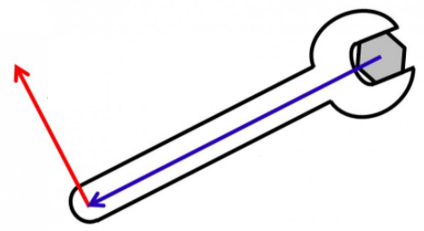


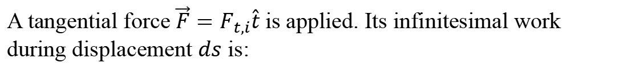


Rotational work: Introduction
$$F_{t,i}\hat{t}$$
$$\vec{r}$$
$$d\vec{s}$$
$$θ$$
$$O$$
A tangential force $\vec{F}=F_{t,i}\hat{t}$is applied. Its infinitesimal work during displacement $ds$ is:
Notes:
PARLER LENTEMENT: As introduction, let’s to consider a tangential force is applied to the tool to rotate the hexagonal piece. This force is tangent to the circular motion described by the dashed line and then, it has the same direction than the infinitesimal displacement ds. The position vector r describe the position of the point of application of the force in respect with O, the pivot point of the rotational motion. We can describe the work done by this tangential force.

Slide 20

Rotational work: Introduction
$$F_{t,i}\hat{t}$$
$$\vec{r}$$
$$d\vec{s}$$
$$θ$$
$$O$$
A tangential force $\vec{F}=F_{t,i}\hat{t}$is applied. Its infinitesimal work during displacement $ds$ is:
$$dW=\vec{F_{i}}.d\vec{s}=F_{t,i}.ds=F_{t,i}rdθ$$
Notes:
PARLER LENTEMENT: The infinitesimal work done by the force during the infinitesimal displacement is the scalar product between the force exerted and the infinitival displacement. ds is also equals to distance r multiplied by infinitesimal angular displacement d_theta during the circular motion.

Slide 21


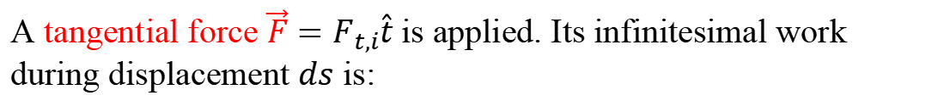
Rotational work: Introduction
$$F_{t,i}\hat{t}$$
$$\vec{r}$$
$$d\vec{s}$$
$$θ$$
$$O$$
A tangential force $\vec{F}=F_{t,i}\hat{t}$is applied. Its infinitesimal work during displacement $ds$ is:
$$dW=\vec{F_{i}}.d\vec{s}=F_{t,i}.ds=F_{t,i}rdθ$$
$$dW=τ_{i}dθ$$
where $τ$ is the torque done by the tangential force
Notes:
PARLER LENTEMENT: The product between the magnitude of the tangential force and the distance r is also the torque done about the pivot point O. So the infinitesimal work is the torque exerted about O and the infinitesimal angular displacement d_theta.

Slide 22

Rotational work: Introduction
$$F_{t,i}\hat{t}$$
$$\vec{r}$$
$$d\vec{s}$$
$$θ$$
$$O$$
A tangential force $\vec{F}=F_{t,i}\hat{t}$is applied. Its infinitesimal work during displacement $ds$ is:
$$dW=\vec{F_{i}}.d\vec{s}=F_{t,i}.ds=F_{t,i}rdθ$$
$$dW=τ_{i}dθ$$
where $τ$ is the torque done by the tangential force
$$\int{dW}=\int{τ_{i}dθ }$$
Notes:
PARLER LENTEMENT: Then, we calculate the integral at the left side and at the right side of the equation, which permit to describe the work done during the rotational motion between two angular positions of the tool.

Slide 23
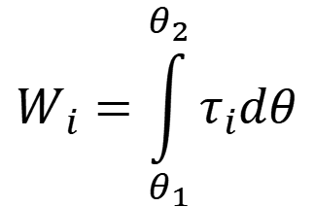
Rotational work
The work done by a force acting on the rotation of a body by the torque $τ_{i}$ about the pivot point is, during angular displacement from $θ_{1}$ to $θ_{2}$:
$$W_{i}=\int_{θ_{1}}^{θ_{2}}{τ_{i}dθ}$$
Important to remember
Notes:
PARLER LENTEMENT: We obtain this expression for the rotational work, which means the work done by a force on a body in rotation when it apply a torque on the body. You don’t need to remember the demonstration but it is important to remember this result. Take care that you cannot put the torque outside the integral for any torque exerted. This depends if the torque exerted is constant during the angular displacement or not.

Slide 24
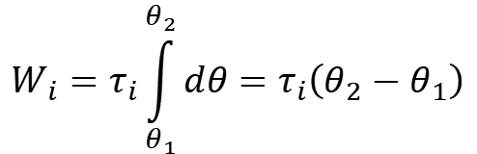
Rotational work
The work done by a force acting on the rotation of a body by the torque $τ_{i}$ about the pivot point is, during angular displacement from $θ_{1}$ to $θ_{2}$:
$$W_{i}=\int_{θ_{1}}^{θ_{2}}{τ_{i}dθ}$$
Important to remember
$$W_{i}=τ_{i}\int_{θ_{1}}^{θ_{2}}{dθ}=τ_{i}\left(θ_{2}−θ_{1}\right)$$
If the torque by the force is constant
Notes:
PARLER LENTEMENT: If the torque exerted is constant, then you can put the torque outside the integral, and we obtain that the rotational work is the product between the torque and the angular displacement theta_2 minus theta_1. In any other situation, you will have an integral calculation to do so you should be able to describe what is the magnitude of the torque done by the force about the pivot point to describe its rotational work,

Slide 25
Rotational work
The work done by a force acting on the rotation of a body by the torque $τ_{i}$ about the pivot point is, during angular displacement from $θ_{1}$ to $θ_{2}$:
$$W_{i}=\int_{θ_{1}}^{θ_{2}}{τ_{i}dθ}$$
Important to remember
$$W_{i}=τ_{i}\int_{θ_{1}}^{θ_{2}}{dθ}=τ_{i}\left(θ_{2}−θ_{1}\right)$$
If the torque by the force is constant
Only the tangential component of the acting force does work during the rotation of the body.
Notes:
PARLER LENTEMENT: Also, take care that only the tangential component of the force does a rotational work during the rotation of the body. To be convinced about it, a simple way you can do is to try to calculate the rotational work done by a force which has no tangential component, and you will find this rotational work is zero.

Slide 26
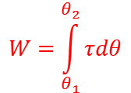
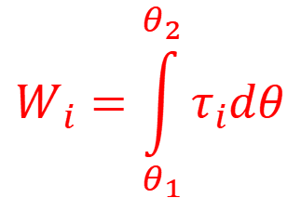
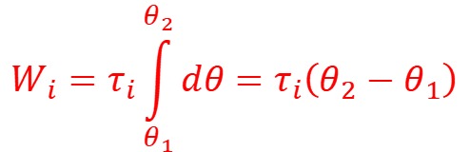
Rotational work
The work done by a force acting on the rotation of a body by the torque $τ_{i}$ about the pivot point is, during angular displacement from $θ_{1}$ to $θ_{2}$:
$$W_{i}=\int_{θ_{1}}^{θ_{2}}{τ_{i}dθ}$$
Important to remember
$$W_{i}=τ_{i}\int_{θ_{1}}^{θ_{2}}{dθ}=τ_{i}\left(θ_{2}−θ_{1}\right)$$
If the torque by the force is constant
Only the tangential component of the acting force does work during the rotation of the body.
The net rotational work, corresponding to the net torque, $\vec{τ}=\sum{\vec{τ_{i}}}$ is:
$$W=\int_{θ_{1}}^{θ_{2}}{τdθ}$$
Important to remember
Notes:
PARLER LENTEMENT: Considering many forces exert a torque on a body in rotation, we can describe the net rotational work, which is the sum of all the rotational works exerted on the body in rotation. It is the integral over the angular displacement of the magnitude of the net torque exerted. If this net torque is constant, you can put it outside the integral.

Slide 27

Rotational work
We have seen that the net work on a body in rotation (about a point of the axis of rotation ) is related with the angular acceleration $\vec{α}$:
$$\vec{τ}=I\vec{α}$$
Notes:
PARLER LENTEMENT: Now, let’s see the relation between the net rotational work on a body in rotation and the moment of inertia. We know that the net torque exerted on the body in rotation about the axis of rotational motion is the moment of inertia about this axis of rotational motion multiplied by the angular acceleration vector of the body, which describe its rotational motion. This is the rotational analogy of the Newton second law.

Slide 28
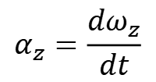
Rotational work
We have seen that the net work on a body in rotation (about a point of the axis of rotation ) is related with the angular acceleration $\vec{α}$:
$$\vec{τ}=I\vec{α}$$
z-component of angular acceleration (if the z-axis is the axis of rotation):
$$α_{z}=\frac{dω_{z}}{dt}$$
Notes:
PARLER LENTEMENT: And we can describe the z-component of the angular acceleration vector as the time derivative of the z-component of the angular velocity vector.

Slide 29
Rotational work
We have seen that the net work on a body in rotation (about a point of the axis of rotation ) is related with the angular acceleration $\vec{α}$:
$$\vec{τ}=I\vec{α}$$
z-component of angular acceleration (if the z-axis is the axis of rotation):
$$α_{z}=\frac{dω_{z}}{dt}$$
At time $t=t_{1}$, the body in rotation has angular velocity $ω_{z,1}=ω_{z}(t_{1}),$
At time $t=t_{2}$, the body in rotation has angular velocity $ω_{z,2}=ω_{z}(t_{2}),$
Exercise (5 minutes) : Describe the rotational work done by the net torque in terms of rotational kinetic energy at times $t=t_{1}$ and time $t=t_{2}.$
Notes:
PARLER LENTEMENT: We have described the net torque on a body in rotation is related with its angular acceleration vector. We have also described the angular acceleration is the change rate of the angular velocity. Please to use these statements to describe the rotational work done by the net torque on a body between two times in terms of rotational kinetic energy at these two times. Maybe you could find this relationship directly from the analogy with the translational motion and the translational kinetic energy, but please to do the mathematical demonstration.

Slide 30
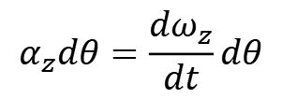
Rotational work
We have seen that the net work on a body in rotation (about a point of the axis of rotation ) is related with the angular acceleration $\vec{α}$:
$$\vec{τ}=I\vec{α}$$
z-component of angular acceleration (if the z-axis is the axis of rotation):
$$α_{z}=\frac{dω_{z}}{dt}$$
$$α_{z}dθ=\frac{dω_{z}}{dt}dθ$$
Notes:
PARLER LENTEMENT: We multiply both sides of the equation by the infinitesimal angular displacement d_theta.

Slide 31

Rotational work
We have seen that the net work on a body in rotation (about a point of the axis of rotation ) is related with the angular acceleration $\vec{α}$:
$$\vec{τ}=I\vec{α}$$
z-component of angular acceleration (if the z-axis is the axis of rotation):
$$α_{z}=\frac{dω_{z}}{dt}$$
$$α_{z}dθ=\frac{dω_{z}}{dt}dθ$$
$$α_{z}dθ=ω_{z}dω_{z}$$
Notes:
PARLER LENTEMENT: We obtain that the angular acceleration multiplied by d_theta equals to the angular velocity multiplied by the infinitesimal change of angular velocity d_omega.

Slide 32
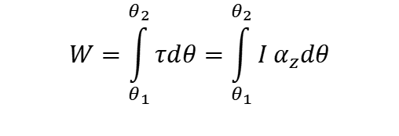
Rotational work
We have seen that the net work on a body in rotation (about a point of the axis of rotation ) is related with the angular acceleration $\vec{α}$:
$$\vec{τ}=I\vec{α}$$
z-component of angular acceleration (if the z-axis is the axis of rotation):
$$α_{z}=\frac{dω_{z}}{dt}$$
$$α_{z}dθ=\frac{dω_{z}}{dt}dθ$$
$$α_{z}dθ=ω_{z}dω_{z}$$
The work done by the net force which rotating the body is:
$$W=\int_{θ_{1}}^{θ_{2}}{τdθ}=\int_{θ_{1}}^{θ_{2}}{I α_{z}dθ}$$
Notes:
PARLER LENTEMENT: Thus, we can put in the expression of the net rotational work the expression of the net work. You can see that inside the integral is appears the product of the moment of inertia about the axis of rotation, and the angular acceleration.

Slide 33
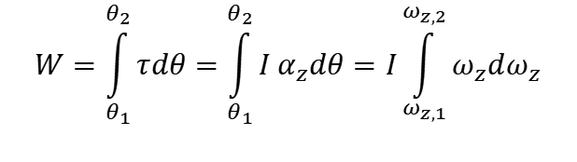
Rotational work
We have seen that the net work on a body in rotation (about a point of the axis of rotation ) is related with the angular acceleration $\vec{α}$:
$$\vec{τ}=I\vec{α}$$
z-component of angular acceleration (if the z-axis is the axis of rotation):
$$α_{z}=\frac{dω_{z}}{dt}$$
$$α_{z}dθ=\frac{dω_{z}}{dt}dθ$$
$$α_{z}dθ=ω_{z}dω_{z}$$
The work done by the net force which rotating the body is:
$$W=\int_{θ_{1}}^{θ_{2}}{τdθ}=\int_{θ_{1}}^{θ_{2}}{I α_{z}dθ}=I\int_{ω_{z,1}}^{ω_{z,2}}{ω_{z}dω_{z}}$$
Notes:
PARLER LENTEMENT: The moment of inertia about an axis of rotation don’t change during the rotational motion for a rigid body. We can put it outside the integral. And we can express the net rotational work as follows. As you see it will depends on the final and initial angular velocity of the body in rotational motion, named here omega_1 and omega_2

Slide 34

Rotational work
We have seen that the net work on a body in rotation (about a point of the axis of rotation ) is related with the angular acceleration $\vec{α}$:
$$\vec{τ}=I\vec{α}$$
z-component of angular acceleration (if the z-axis is the axis of rotation):
$$α_{z}=\frac{dω_{z}}{dt}$$
$$α_{z}dθ=\frac{dω_{z}}{dt}dθ$$
$$α_{z}dθ=ω_{z}dω_{z}$$
The rotational work done by the net torque which rotating the body is:
$$W=\int_{θ_{1}}^{θ_{2}}{τdθ}=\int_{θ_{1}}^{θ_{2}}{I α_{z}dθ}=I\int_{ω_{z,1}}^{ω_{z,2}}{ω_{z}dω_{z}}$$
$$W=\frac{1}{2}Iω_{z,2}^{2}−\frac{1}{2}Iω_{z,1}^{2}$$
The work done by the net torque correspond to the change of the rotational kinetic energy of the body
Notes:
PARLER LENTEMENT: So here is the expression of the net rotational work done during the rotational motion of a body between two instants. The work done by the net torque is simply the change of the rotational kinetic energy of the body. Here also, you can see another example of analogy between the rotational motion and the linear motion.

Slide 35
Rest time (5 minutes)

Slide 36
7.The angular momentum 角动量
Notes:
PARLER LENTEMENT: Let’s finish this lesson by describing the angular momentum.

Slide 37


Net torque acting on a particle
$$y$$
Particle
$$\vec{F}$$
$$\vec{r}$$
O
$$x$$
$$z$$
The net torque acting on a particle about point O is:
$$\vec{τ}=\vec{r}×\vec{F}$$
where $\vec{F}$ is the net force exerted on the particle.
Notes:
PARLER LENTEMENT: To introduce the angular momentum, first let’s consider a particle on which a net force F is exerted. This particle could be inside a body in rotational motion divided in particles. This particle has position vector r and is at distance r from the point O. The net torque acting on a particle about point O is simply the vector product between the position vector of the particle and the net force exerted.

Slide 38
Net torque acting on a particle
$$y$$
Particle
$$\vec{F}$$
$$\vec{r}$$
O
$$x$$
$$z$$
The net torque acting on a particle about point O is:
$$\vec{τ}=\vec{r}×\vec{F}$$
where $\vec{F}$ is the net force exerted on the particle.
Warning: the net torque depends to the choice of the point O.
Notes:
PARLER LENTEMENT: Here also, take care that we always describe a torque about a point, so the net torque exerted on the particle depends to the choice of the point O.

Slide 39
Warning: net torque on a body is not “the torque by the net force”
Notes:
PARLER LENTEMENT: Take care also that the net torque is the not the torque done by the net force, for a body in rotation.

Slide 40







Warning: net torque on a body is not “the torque by the net force”
Imagine a disk who can turns only around its axis of symmetry. Two tension forces using ropes, applied at A and B are used to rotate the disk. They are opposite and have same magnitude (other forces are ignored, they don’t participate to the rotation).
$$A$$
$${\vec{F}}_{A}$$
$${\vec{r}}_{A}$$
$$+O$$
$${\vec{r}}_{B}$$
$${\vec{F}}_{B}$$
$$B$$
The net torque about O is:
Notes:
PARLER LENTEMENT: Imagine a disk who can turns only around its axis of symmetry. There are two tension forces using ropes, applied at A and B are used to rotate the disk. Points A and B have position vector r_A and r_B in respect with O at the center of the disk. These two forces have opposite direction and same magnitude. There is no other forces which participate to the rotation of the disk. We can describe the net torque exerted on the disk about the point O, it is the sum of both torques exerted about O,

Slide 41
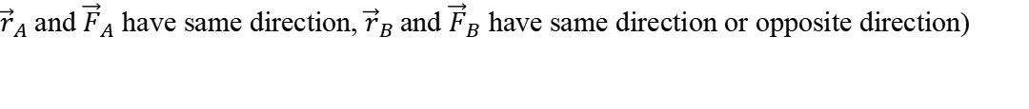

Warning: net torque on a body is not “the torque by the net force”
Imagine a disk who can turns only around its axis of symmetry. Two tension forces using ropes, applied at A and B are used to rotate the disk. They are opposite and have same magnitude (other forces are ignored, they don’t participate to the rotation).
$$A$$
$${\vec{F}}_{A}$$
$${\vec{r}}_{A}$$
$$+O$$
$${\vec{r}}_{B}$$
$${\vec{F}}_{B}$$
$$B$$
The net torque about O is:
$$\vec{τ}={\vec{τ}}_{A}+{\vec{τ}}_{B}=2{\vec{τ}}_{A}=2{\vec{τ}}_{B}≠\vec{0}$$
(excepted if
${\vec{r}}_{A}$and ${\vec{F}}_{A}$ have same direction, ${\vec{r}}_{B}$and ${\vec{F}}_{B}$ have same direction or opposite direction)
Notes:
PARLER LENTEMENT: We obtain this expression, and you can see that the net torque exerted about O is twice the torque exered about force F_A or force F_B. This is because the torque exerted by these forces are equal. Thus, the net torque exerted on the disk is not zero. The only case where the net torque exerted is zero is when the torque exerted by the force F_A or F_B is zero, which happens when they have the same direction than the corresponding position vector, but in all other situations, the net torque isn’t zero.

Slide 42
Warning: net torque on a body is not “the torque by the net force”
Imagine a disk who can turns only around its axis of symmetry. Two tension forces using ropes, applied at A and B are used to rotate the disk. They are opposite and have same magnitude (other forces are ignored, they don’t participate to the rotation).
$$A$$
$${\vec{F}}_{A}$$
$${\vec{r}}_{A}$$
$$+O$$
$${\vec{r}}_{B}$$
$${\vec{F}}_{B}$$
$$B$$
The net torque about O is:
$$\vec{τ}={\vec{τ}}_{A}+{\vec{τ}}_{B}=2{\vec{τ}}_{A}=2{\vec{τ}}_{B}≠\vec{0}$$
(excepted if
${\vec{r}}_{A}$and ${\vec{F}}_{A}$ have same direction, ${\vec{r}}_{B}$and ${\vec{F}}_{B}$ have same direction or opposite direction)
But the “torque done by the net force about O” is $\vec{O}$ because O is the center of mass of the disk (the net force is applied at the center of mass) …
Notes:
PARLER LENTEMENT: But what about the torque done by the net force about O. The torque by the net force about O is always zero here, because the net force is applied on the center of mass of the disk. So, you can see that the net torque on a body is not the torque done by the net force. In fact, a “torque by the net force” is something which is meaningless to study the rotational motion because it is always zero.

Slide 43
Warning: net torque on a body is not “the torque by the net force”
Imagine a disk who can turns only around its axis of symmetry. Two tension forces using ropes, applied at A and B are used to rotate the disk. They are opposite and have same magnitude (other forces are ignored, they don’t participate to the rotation).
$$A$$
$${\vec{F}}_{A}$$
$${\vec{r}}_{A}$$
$$+O$$
$${\vec{r}}_{B}$$
$${\vec{F}}_{B}$$
$$B$$
The net torque about O is:
$$\vec{τ}={\vec{τ}}_{A}+{\vec{τ}}_{B}=2{\vec{τ}}_{A}=2{\vec{τ}}_{B}≠\vec{0}$$
(excepted if
${\vec{r}}_{A}$and ${\vec{F}}_{A}$ have same direction, ${\vec{r}}_{B}$and ${\vec{F}}_{B}$ have same direction or opposite direction)
But the “torque done by the net force about O” is $\vec{O}$ because O is the center of mass of the disk (the net force is applied at the center of mass) …
It is meaningless to speak about “torque by net force” for a rigid body, “torque by net force” is only meaningful for a particle, which is an ideal point-like body. Net force on a body is used to describe its translational motion, not its rotational motion.
Notes:
PARLER LENTEMENT: It is meaningless to speak about “torque by net force” for a rigid body. The torque by net force is only meaningful for a particle, which is an ideal point-like body. The net force on a body is used to describe its translational motion, the net force is not used to describe the rotational motion of a rigid body.

Slide 44

The angular momentum: introduction
We consider the net force on a particle:
$$\vec{F}=\frac{d\vec{p}}{dt}$$
Newton’s second law
$$y$$
Particle
$$\vec{F}$$
$$\vec{r}$$
O
$$x$$
$$z$$
Notes:
PARLER LENTEMENT: Now, let’s describe the angular momentum of a particle. First we consider the net force exerted on a particle, which is the change rate of its linear momentum p. This is the Newton second law.

Slide 45

The angular momentum: introduction
We consider the net force on a particle:
$$\vec{F}=\frac{d\vec{p}}{dt}$$
Newton’s second law
$$y$$
Particle
$$\vec{F}$$
$$\vec{r}×\vec{F}=\vec{r}×\frac{d\vec{p}}{dt}$$
$$\vec{r}$$
O
$$x$$
$$z$$
Notes:
PARLER LENTEMENT: And from this equation, we can describe that the torque done by the net force exerted on the particle about point O which is also the vector product between the position vector of the particle and the net force is the vector product between its position vector and its change rate of momentum.

Slide 46

The angular momentum: introduction
We consider the net force on a particle:
$$\vec{F}=\frac{d\vec{p}}{dt}$$
Newton’s second law
$$y$$
Particle
$$\vec{F}$$
$$\vec{r}×\vec{F}=\vec{r}×\frac{d\vec{p}}{dt}$$
$$\vec{τ}=\vec{r}×\frac{d\vec{p}}{dt}$$
Net torque on the particle abut O.
$$\vec{r}$$
O
$$x$$
$$z$$
Notes:
PARLER LENTEMENT: We obtain this expression between the net torque on the particle and the change rate of momentum of the particle. I remind you that torque by the net force is only meaningful for a particle, and is meaningless for rigid body

Slide 47
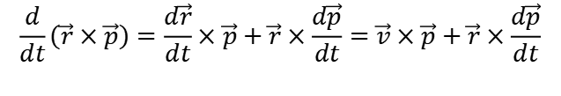
The angular momentum: introduction
We consider the net force on a particle:
$$\vec{F}=\frac{d\vec{p}}{dt}$$
Newton’s second law
$$y$$
Particle
$$\vec{F}$$
$$\vec{r}×\vec{F}=\vec{r}×\frac{d\vec{p}}{dt}$$
$$\vec{τ}=\vec{r}×\frac{d\vec{p}}{dt}$$
Net torque on the particle
$$\vec{r}$$
$$\frac{d}{dt}\left(\vec{r}×\vec{p}\right)=\frac{d\vec{r}}{dt}×\vec{p}+\vec{r}×\frac{d\vec{p}}{dt}=\vec{v}×\vec{p}+\vec{r}×\frac{d\vec{p}}{dt}$$
O
$$x$$
$$z$$
Notes:
PARLER LENTEMENT: Now, let’s describe the change rate of the vector product between the position vector and the momentum p, you can see that it is the sum of two terms. The first term is the vector product between the velocity vector v and the momentum p, plus a second term which is the vector product between the position vector r and the change rate of momentum.

Slide 48

The angular momentum: introduction
We consider the net force on a particle:
$$\vec{F}=\frac{d\vec{p}}{dt}$$
Newton’s second law
$$\vec{r}×\vec{F}=\vec{r}×\frac{d\vec{p}}{dt}$$
$$\vec{τ}=\vec{r}×\frac{d\vec{p}}{dt}$$
Net torque on the particle about O
$$\frac{d}{dt}\left(\vec{r}×\vec{p}\right)=\frac{d\vec{r}}{dt}×\vec{p}+\vec{r}×\frac{d\vec{p}}{dt}=\vec{v}×\vec{p}+\vec{r}×\frac{d\vec{p}}{dt}$$
$$\vec{v}×m\vec{v}=\vec{0}$$
Notes:
PARLER LENTEMENT: But this expression can be simplified because the velocity vector and the momentum has same direction so their vector product is zero.

Slide 49

The angular momentum: introduction
We consider the net force on a particle:
$$\vec{F}=\frac{d\vec{p}}{dt}$$
Newton’s second law
$$\vec{r}×\vec{F}=\vec{r}×\frac{d\vec{p}}{dt}$$
$$\vec{τ}=\vec{r}×\frac{d\vec{p}}{dt}$$
Net torque on the particle
$$\frac{d}{dt}\left(\vec{r}×\vec{p}\right)=\frac{d\vec{r}}{dt}×\vec{p}+\vec{r}×\frac{d\vec{p}}{dt}=\vec{v}×\vec{p}+\vec{r}×\frac{d\vec{p}}{dt}$$
$$\vec{v}×m\vec{v}=\vec{0}$$
$$\vec{τ}=\frac{d}{dt}\left(\vec{r}×\vec{p}\right)$$
Notes:
PARLER LENTEMENT: Thus, we obtain that the net torque on a particle is the change rate of the vector product between its position vector and its momentum.

Slide 50

The angular momentum: introduction
We consider the net force on a particle:
$$\vec{F}=\frac{d\vec{p}}{dt}$$
Newton’s second law
$$\vec{r}×\vec{F}=\vec{r}×\frac{d\vec{p}}{dt}$$
$$\vec{τ}=\vec{r}×\frac{d\vec{p}}{dt}$$
Net torque on the particle
$$\frac{d}{dt}\left(\vec{r}×\vec{p}\right)=\frac{d\vec{r}}{dt}×\vec{p}+\vec{r}×\frac{d\vec{p}}{dt}=\vec{v}×\vec{p}+\vec{r}×\frac{d\vec{p}}{dt}$$
$$\vec{v}×m\vec{v}=\vec{0}$$
$$\vec{τ}=\frac{d}{dt}\left(\vec{r}×\vec{p}\right)$$
Angular momentum
$$\vec{L}=\vec{r}×\vec{p}$$
Notes:
PARLER LENTEMENT: As the net force is the change rate of a linear momentum, the net torque on the particle is the change rate of the angular momentum L, which is described as follows: it is the vector product between the position vector and its momentum,

Slide 51

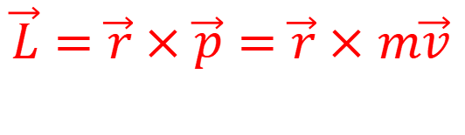
The angular momentum of a particle
Angular momentum about point O of a particle of mass m moving at velocity $\vec{v}$
$$\vec{L}=\vec{r}×\vec{p}=\vec{r}×m\vec{v}$$
Important to remember
$$y$$
$$\vec{p}=m\vec{v}$$
$$\vec{r}$$
O
$$x$$
$$z$$
Notes:
PARLER LENTEMENT: Please to remember this expression which describe the angular momentum of a particle. Take care that as for the torque, we speak about the angular momentum about a point, here the point O because the angular momentum depends to the point O chosen, which is because it is involved the position vector of the particle and its velocity vector. Of course, you don’t need to remember the demonstration which permits to obtain this result.

Slide 52


The angular momentum of a particle
Angular momentum about point O of a particle of mass m moving at velocity $\vec{v}$
$$\vec{L}=\vec{r}×\vec{p}=\vec{r}×m\vec{v}$$
Important to remember
p是动量
$$y$$
$$\vec{p}=m\vec{v}$$
The net torque on a particle about point O is the rate change of its angular momentum about O :
$$\vec{τ}=\frac{d\vec{L}}{dt}=\vec{r}×\vec{F}$$
$$\vec{r}$$
O
where $\vec{F}$ is the net force exerted on the particle
$$x$$
$$z$$
Notes:
PARLER LENTEMENT: And an important property about the net torque on a particle is that it is also the change rate of its angular momentum.

Slide 53
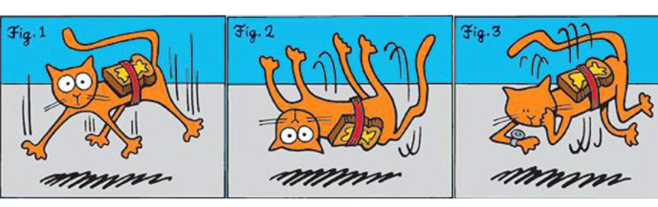
Question: What can we say about the angular momentum of a falling cat about its center of mass ?
A western joke: a falling cat lands always on his feet and a bread fall always on the buttered side. Put them together and you have a levitating cat !
Notes:
PARLER LENTEMENT: We have described the angular momentum of a particle. Can we use it to describe the angular momentum of a rigid body. It is something we will see. About the picture is a kind of joke in western. When we let a bread with butter to fall, the bread fall on the ground on the buttered side. And we say that a cat fall always on his feet, so if you put a cat and bread with butter together, you obtain a levitating cat. This picture is just to introduce a question about a falling cat. What can say about the angular momentum of a falling cat ? Does it change ? Does is stay constant ? And why ?

Slide 54

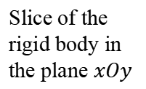


The angular momentum of a rigid body
A rigid body in rotation around the z-axis is considered as a system of N particles of angular momentum ${\vec{L}}_{i}$
$$y$$
$$\vec{p_{i}}=m_{i}\vec{v_{i}}$$
$$\vec{r_{i}}$$
O
$$x$$
$$\vec{L_{i}}$$
Slice of the rigid body in the plane $xOy$
$$z$$
Notes:
PARLER LENTEMENT: First, lets describe the angular momentum of a rigid body. In the figure is a rigid body in rotational motion around the z-axis. The dashed curve show the circular of a point in this body, The rigid body is divided in N particles which as a certain position vector r_i , a certain momentum p_i, a mass m_i, and a velocity vector v_i. And we consider a slice of the body on the plane xOy. The particles in that plane have velocity vector and momentum in that plane. And they have an angular momentum L_i along the z-axis because their angular momentum is the vector product between their position vector about O and their momentum.

Slide 55
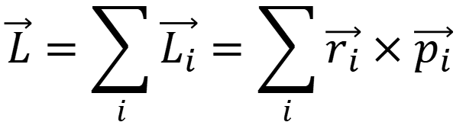
The angular momentum of a rigid body
A rigid body in rotation around the z-axis is considered as a system of N particles of angular momentum ${\vec{L}}_{i}$
The angular momentum of the rigid body about point O is:
$$\vec{L}=\sum_{i}{\vec{L_{i}}}=\sum_{i}{\vec{r_{i}}×\vec{p_{i}}}$$
$$y$$
$$\vec{p_{i}}=m_{i}\vec{v_{i}}$$
$$\vec{r_{i}}$$
O
$$x$$
$$\vec{L_{i}}$$
Slice of the rigid body in the plane $xOy$
$$z$$
Notes:
PARLER LENTEMENT: The angular momentum of the rigid body about point O is simply the sum of all angular momentum about point O of the particles in the rigid body.

Slide 56
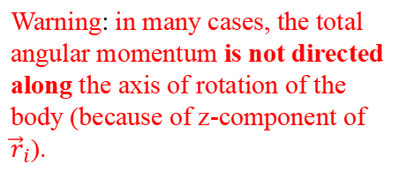
The angular momentum of a rigid body
A rigid body in rotation around the z-axis is considered as a system of N particles of angular momentum ${\vec{L}}_{i}$
The angular momentum of the rigid body about point O is:
$$\vec{L}=\sum_{i}{\vec{L_{i}}}=\sum_{i}{\vec{r_{i}}×\vec{p_{i}}}$$
$$y$$
$$\vec{p_{i}}=m_{i}\vec{v_{i}}$$
Warning: in many cases, the total angular momentum is not directed along the axis of rotation of the body (because of z-component of ${\vec{r}}_{i}$).
$$\vec{r_{i}}$$
O
$$x$$
$$\vec{L_{i}}$$
Slice of the rigid body in the plane $xOy$
$$z$$
Notes:
PARLER LENTEMENT: Take care that in many cases, the total angular momentum of the rigid body is not directed along the axis of rotational motion, because of the position vector of the particles have a z-component.

Slide 57
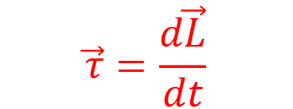
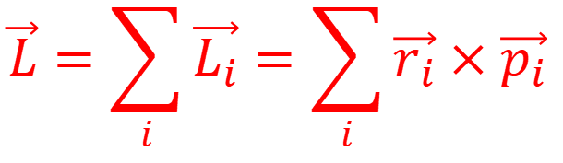
The angular momentum of a rigid body
A rigid body in rotation around the z-axis is considered as a system of N particles of angular momentum ${\vec{L}}_{i}$
The angular momentum of the rigid body about point O is:
$$\vec{L}=\sum_{i}{\vec{L_{i}}}=\sum_{i}{\vec{r_{i}}×\vec{p_{i}}}$$
$$y$$
$$\vec{p_{i}}=m_{i}\vec{v_{i}}$$
The net torque on the rigid body about point O is the rate of change of its angular momentum about point O:
$$\vec{r_{i}}$$
$$\vec{τ}=\frac{d\vec{L}}{dt}$$
O
$$x$$
$$\vec{L_{i}}$$
$$z$$
Notes:
PARLER LENTEMENT: And from the expression of the total angular momentum of the rigid body, we obtain that the net torque on the rigid body about point O is the change rate about O of its total angular momentum.

Slide 58
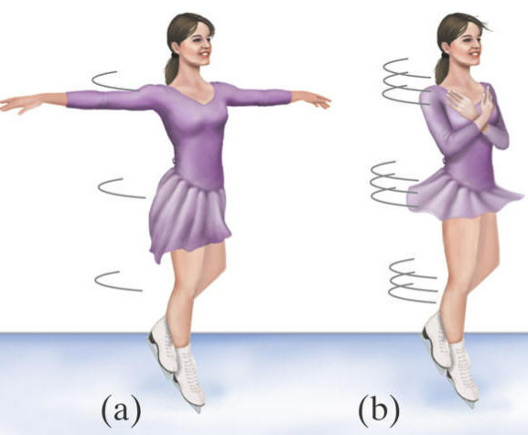
The angular momentum of a rigid body
Question: What does the figure skater to spin faster and why ? (i.e. to have a greater angular velocity)
Notes:
PARLER LENTEMENT: Before to introduce the relation between the angular momentum, let’s see the situation of a figure skater. In the position shown in the figure, she spin slowly, and then she want to spin faster. So, what does she do in that purpose ?

Slide 59
The angular momentum of a rigid body
Question: What does the figure skater to spin faster and why ? (i.e. to have a greater angular velocity)
Notes:
PARLER LENTEMENT: She will change her moment of inertia about her axis of rotation. The smallest is the moment of inertia and the biggest will be her angular velocity. During her spinning her angular momentum doesn’t change. It’s change because of the friction with the ice and the air, but we can ignore the friction. Thus, there is a relationship between the moment of inertia, the angular velocity and the angular momentum we want to describe

Slide 60



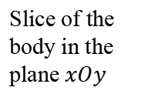


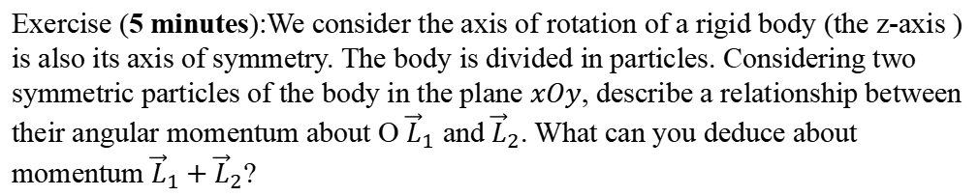
The angular momentum of a rigid body
Particular case: if the axis of rotation is also an axis of symmetry of the rigid body
$$y$$
$$\vec{p_{1}}$$
O
$$\vec{r_{1}}$$
$$\vec{r_{2}}$$
$$x$$
$$\vec{L_{1}}$$
$$\vec{p_{2}}=−\vec{p_{1}}$$
Slice of the body in the plane $xOy$
$$z$$
Exercise (5 minutes):We consider the axis of rotation of a rigid body (the z-axis ) is also its axis of symmetry. The body is divided in particles. Considering two symmetric particles of the body in the plane $xOy$, describe a relationship between their angular momentum about O ${\vec{L}}_{1}$ and ${\vec{L}}_{2}$. What can you deduce about momentum ${\vec{L}}_{1}+{\vec{L}}_{2}$?
Notes:
PARLER LENTEMENT: Here is a little exercise considering a particular case. The z-axis is the axis of rotational motion of the rigid body but It is also an axis of symmetry of the rigid body. Thus, for any particle in the plane xOy of position vector r_1, there is a symmetric particle of position vector r_2. As you can see on the figure, their momentum have equal magnitude and opposite direction. First please to describe a relation between their angular momentum about O, Then, please to say what you can deduce about the angular momentum about O of the slice of the rigid body in the xOy plane ?

Slide 61


The angular momentum of a rigid body
Particular case: if the axis of rotation is also an axis of symmetry of the rigid body
$$y$$
For two symmetrical particles in the plane $xOy$:
$${\vec{L}}_{1}=\vec{L_{2}}$$
$$\vec{p_{1}}$$
O
$$\vec{r_{1}}$$
$$\vec{r_{2}}$$
$$x$$
$$\vec{L_{1}}$$
$$\vec{p_{2}}=−\vec{p_{1}}$$
Slice of the body in the plane $xOy$
$$z$$
Notes:
PARLER LENTEMENT: First, the position vectors of the symmetric particles have same magnitude and opposite direction. Their momentum have also same magnitude and opposite direction. We obtain that the both symmetric particles have same angular momentum about O.

Slide 62
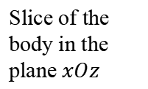

The angular momentum of a rigid body
Particular case: if the axis of rotation is also an axis of symmetry of the rigid body
$$y$$
For two symmetrical particles in the plane $xOy$:
$${\vec{L}}_{1}=\vec{L_{2}}$$
${\vec{L}}_{1}+\vec{L_{2}}$ directed toward the +z-direction
$$\vec{p_{1}}$$
O
$$\vec{r_{1}}$$
$$\vec{r_{2}}$$
$$x$$
$$\vec{L_{1}}$$
$$\vec{p_{2}}=−\vec{p_{1}}$$
Slice of the body in the plane $xOz$
$$z$$
$${\vec{L}}_{1}=\vec{r_{1}}×\vec{p_{1}}$$
$${\vec{L}}_{2}=\vec{r_{2}}×\vec{p_{2}}=\left(−\vec{r_{1}}\right)×−\left(\vec{p_{1}}\right)=\vec{r_{1}}×\vec{p_{1}}$$
Notes:
PARLER LENTEMENT: Thus, the sum of their angular momentum is also directed toward along the z-axis, as their angular momentum. Now what about the pairs of symmetrical particles which are not is the plane xOy ?

Slide 63









The angular momentum of a rigid body
Particular case: the axis of rotation is also an axis of symmetry
$$z$$
What about pairs of symmetrical particles in the other slices of the body ?
$${\vec{L}}_{2}$$
$${\vec{L}}_{1}$$
$$⨀$$
$$⨂$$
$${\vec{p}}_{2}$$
$${\vec{p}}_{1}$$
$${\vec{r}}_{2}$$
$${\vec{r}}_{1}$$
$$O$$
$$x$$
Notes:
PARLER LENTEMENT: As previously, we consider two symmetric particles in the rigid body, but now we consider the particles are in any slice. Their momentum have still same magnitude and opposite direction. Their position vector have same magnitude but don’t have opposite directions. And their angular momentum have same magnitude but don’t have the same direction, as you can see on the figure, However, what can we say about the sum of their angular momentum about O ?

Slide 64

The angular momentum of a rigid body
Particular case: the axis of rotation is also an axis of symmetry
$$z$$
What about pairs of symmetrical particles in the other slices of the body ?
$${\vec{L}}_{2}$$
$${\vec{L}}_{1}$$
${\vec{L}}_{1}+{\vec{L}}_{2}$ is directed toward the axis of rotation (the z-axis here) !
$$⨀$$
$$⨂$$
$${\vec{p}}_{2}$$
$${\vec{p}}_{1}$$
$${\vec{r}}_{2}$$
$${\vec{r}}_{1}$$
$$O$$
$$x$$
Notes:
PARLER LENTEMENT: The sum of their angular momentum is also directed toward the +-z-direction, where the z-axis is the axis of symmetry of the rigid body and the axis of rotational motion.

Slide 65
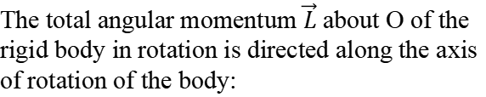
The angular momentum of a rigid body
Particular case: the axis of rotation is also an axis of symmetry
$$z$$
What about pairs of symmetrical particles in the other slices of the body ?
$${\vec{L}}_{2}$$
$${\vec{L}}_{1}$$
${\vec{L}}_{1}+{\vec{L}}_{2}$ is directed toward the axis of rotation (the z-axis here) !
$$⨀$$
$$⨂$$
The total angular momentum $\vec{L}$ about O of the rigid body in rotation is directed along the axis of rotation of the body:
$${\vec{p}}_{2}$$
$${\vec{p}}_{1}$$
$${\vec{r}}_{2}$$
$${\vec{r}}_{1}$$
$$O$$
$$x$$
Notes:
PARLER LENTEMENT: Thus, for any particle in the body there is a corresponding symmetric particle which the sum of both angular momentum will be directed toward the axis of rotation. We deduce that the total angular momentum of the body is directed toward the axis of the rotational motion of the body,

Slide 66

The angular momentum of a rigid body
Particular case: the axis of rotation is also an axis of symmetry
$$z$$
What about pairs of symmetrical particles in the other slices of the body ?
$${\vec{L}}_{2}$$
$${\vec{L}}_{1}$$
${\vec{L}}_{1}+{\vec{L}}_{2}$ is directed toward the axis of rotation (the z-axis here) !
$$⨀$$
$$⨂$$
The total angular momentum $\vec{L}$ about O of the rigid body in rotation is directed along the axis of rotation of the body:
$${\vec{p}}_{2}$$
$${\vec{p}}_{1}$$
$${\vec{r}}_{2}$$
$${\vec{r}}_{1}$$
$$\vec{L}∝\vec{ω}$$
$$O$$
$$x$$
Notes:
PARLER LENTEMENT: Which means that the total angular momentum of the rigid body is proportional with the angular velocity vector of the body. The total angular momentum have same direction that the angular velocity vector of a body if the axis of rotational motion is an axis of symmetry of the body.

Slide 67


The angular momentum of a rigid body
Particular case: the axis of rotation is also an axis of symmetry
$$z$$
What about pairs of symmetrical particles in the other slices of the body ?
$${\vec{L}}_{2}$$
$${\vec{L}}_{1}$$
${\vec{L}}_{1}+{\vec{L}}_{2}$ is directed toward the axis of rotation (the z-axis here) !
$$⨀$$
$$⨂$$
The total angular momentum $\vec{L}$ about O of the rigid body in rotation is directed along the axis of rotation of the body:
$${\vec{p}}_{2}$$
$${\vec{p}}_{1}$$
$${\vec{r}}_{2}$$
$${\vec{r}}_{1}$$
$$\vec{L}∝\vec{ω}$$
$$O$$
$$x$$
For the i-th particle in the $xOy$plane, its angular momentum is.
$$L_{i}=\left|\vec{r_{i}}×\vec{p_{i}}\right|=r_{i}m_{i}v_{i}=m_{i}r_{i}^{2}ω_{i}$$
Notes:
PARLER LENTEMENT: For a particle in the plane xOy, you can see that the magnitude of its angular momentum about O is the mass of the particle multiplied by the square of its distance from point O multiplied by the angular velocity of the particle.

Slide 68

The angular momentum of a rigid body
Particular case: the axis of rotation is also an axis of symmetry
$$z$$
What about pairs of symmetrical particles in the other slices of the body ?
$${\vec{L}}_{2}$$
$${\vec{L}}_{1}$$
${\vec{L}}_{1}+{\vec{L}}_{2}$ is directed toward the axis of rotation (the z-axis here) !
$$⨀$$
$$⨂$$
The total angular momentum $\vec{L}$ about O of the rigid body in rotation is directed along the axis of rotation of the body:
$${\vec{p}}_{2}$$
$${\vec{p}}_{1}$$
$${\vec{r}}_{2}$$
$${\vec{r}}_{1}$$
$$\vec{L}∝\vec{ω}$$
$$O$$
$$x$$
For the i-th particle in the $xOy$plane, its angular momentum is.
$$L_{i}=\left|\vec{r_{i}}×\vec{p_{i}}\right|=r_{i}m_{i}v_{i}=m_{i}r_{i}^{2}ω_{i}$$
The total angular momentum of a rigid body rotating around an axis of symmetry is about a point O on this axis:
$$\vec{L}=I\vec{ω}$$
Notes:
PARLER LENTEMENT: This expression can be generalized to describe the total angular momentum of the rigid body. If the body is rotating around its axis of symmetry, its angular momentum is the product between the moment of inertia about its axis of rotation and its velocity vector. Here also, you can see an analogy between the translational motion and the rotational motion.

Slide 69

The angular momentum of a rigid body
Particular case: the axis of rotation is also an axis of symmetry
The total angular momentum of a rigid body rotating around an axis of symmetry is about a point O on this axis:
$$\vec{L}=I\vec{ω}$$
Important to remember (you don’t need to remember the demonstration)
where
$I$ is the moment of inertia of the body about the axis of rotation
$\vec{ω}$ is the velocity vector describing the rotational motion
Notes:
PARLER LENTEMENT: Please to remember this particular case, because it will be very useful to describe the rotational motion of a rigid body if its axis of rotational motion is also an axis of symmetry,

Slide 70

The angular momentum of a rigid body
Particular case: the axis of rotation is also an axis of symmetry
The total angular momentum of a rigid body rotating around an axis of symmetry is about a point O on this axis:
$$\vec{L}=I\vec{ω}$$
Important to remember (you don’t need to remember the demonstration)
where
$I$ is the moment of inertia of the body about the axis of rotation
$\vec{ω}$ is the velocity vector describing the rotational motion
If the axis of rotation is not an axis of symmetry of the body:
$$\vec{L}≠I\vec{ω}$$
Usually, we will not consider this case …
Notes:
PARLER LENTEMENT: But take care that if the axis of rotational motion is not an axis of symmetry, then the previous expression is not valid. Usually, we will not consider this situation, and we will focus about bodies rotating around an axis of symmetry,

Slide 71


The angular momentum of a rigid body
Principle of conservation of “linear” momentum:
$$\vec{F}=\frac{d\vec{p}}{dt}$$
If the net force on the body is zero, its momentum don’t change
$$\frac{d\vec{p}}{dt}=0$$
$$\vec{F}=\vec{0}$$
Notes:
PARLER LENTEMENT: Let’s see other analogies between translational and rotational motion. From the Newton second law, we describe a principle of conservation of the linear momentum of the body, If the net force exerted on the body is zero, its momentum don’t change.

Slide 72

The angular momentum of a rigid body
Principle of conservation of “linear” momentum:
$$\vec{F}=\frac{d\vec{p}}{dt}$$
If the net force on the body is zero, its momentum don’t change
$$\frac{d\vec{p}}{dt}=0$$
$$\vec{F}=\vec{0}$$
Principle of conservation of angular momentum:
$$\vec{τ}=\frac{d\vec{L}}{dt}$$
If the net torque on the body about a point O on axis of rotation is zero, its angular momentum about this point don’t change
Notes:
PARLER LENTEMENT: Similarly about a body in rotational motion, if the net torque about a point is zero, thus its angular momentum about this point don’t change.

Slide 73


The angular momentum of a rigid body
Principle of conservation of “linear” momentum:
$$\vec{F}=\frac{d\vec{p}}{dt}$$
If the net force on the body is zero, its momentum don’t change
$$\frac{d\vec{p}}{dt}=0$$
$$\vec{F}=\vec{0}$$
Principle of conservation of angular momentum:
$$\vec{τ}=\frac{d\vec{L}}{dt}$$
If the net torque on the body about a point O on axis of rotation is zero, its angular momentum about this point don’t change
$$\frac{d\vec{L}}{dt}=0$$
$$\vec{τ}=\vec{0}$$
Notes:
PARLER LENTEMENT: Which is described by the following equation.

Slide 74
The angular momentum of a rigid body
Principle of conservation of “linear” momentum:
$$\vec{F}=\frac{d\vec{p}}{dt}$$
If the net force on the body is zero, its momentum don’t change
$$\frac{d\vec{p}}{dt}=0$$
$$\vec{F}=\vec{0}$$
Principle of conservation of angular momentum:
$$\vec{τ}=\frac{d\vec{L}}{dt}$$
If the net torque on the body about a point O on axis of rotation is zero, its angular momentum about this point don’t change
$$\frac{d\vec{L}}{dt}=0$$
$$\vec{τ}=\vec{0}$$
The body continue to rotates (at angular velocity $ω=L/I$ if the its rotates around an axis of symmetry) or stay at rest (it don’t rotates).
Notes:
PARLER LENTEMENT: Thus, the body can continue to rotates even if no torque is exerted on the body. It will rotates with a certain angular velocity. If the body rotates around an axis of symmetry, its angular velocity is its total angular momentum divided by its moment of inertia about the axis of rotational motion. Of course another possibility is that the body didn’t rotate and in that case, the body still stay at rest if no torque is exerted.

Slide 75
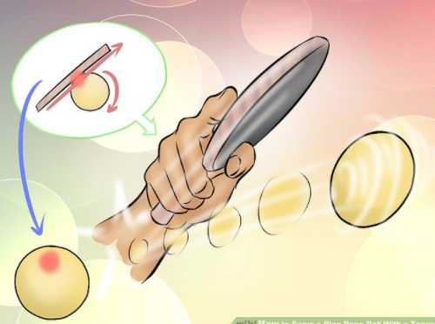

The angular momentum of a rigid body
$$\vec{τ}=\frac{d\vec{L}}{dt}$$
If the net torque on the body is zero, its angular momentum don’t change
$$\frac{d\vec{L}}{dt}=0$$
$$\vec{τ}=\vec{0}$$
The body continue to rotates (at angular velocity $ω=L/I$ if the its rotates around axis of symmetry) or stay at rest (it don’t rotates).
This explains the rotation of a ping pong ball in air or spinning top in table when no torque is applied during its motion (but the angular velocity will decrease and rotation stop because of the friction, so the net torque is not strictly zero).
Notes:
PARLER LENTEMENT: This explains the rotation of a ping pong ball in air or spinning top in table when no torque is applied during its motion. This is not strictly right because there is always friction force exerted on the ping pong ball or the spinning top. The angular velocity will decrease and rotation stop because of the friction, the net torque is not strictly zero.

Slide 76
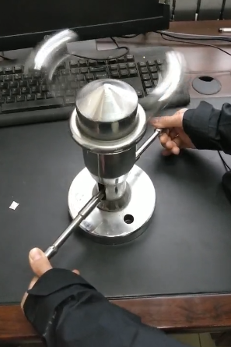
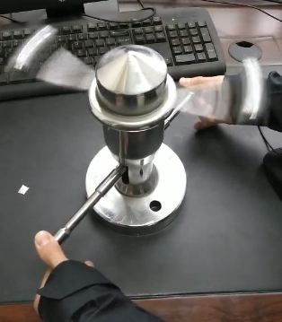


Angular momentum of a rigid body around its axis of symmetry: example
If the axis of rotation is axis of symmetry, the angular momentum is
$$\vec{L}=I\vec{ω}$$
$$L=Iω$$
No net torque exerted during the rotation
$L$ is constant
If the moment of inertia decrease, the angular velocity increase
Notes:
PARLER LENTEMENT: In this experiment, the axis of rotation is also an axis of symmetry. During the rotational motion, we can change the moment of inertia by changing by acting on the cylinders at the base with our hands. Considering the angular momentum stays constant, which is not strictly right because there is friction exerted, the angular velocity increase,

Slide 77


About the falling cat
No net external torque on the cat about its center of mass (friction ignored, weight applied at its center of mass)
$$\vec{τ}=0$$
Notes:
PARLER LENTEMENT: No what about our example of falling cat. If we ignore the friction with air, no external torque is exerted on the falling cat about a point of center of mass which is also a point of its axis of rotation. The weigh don’t exert a torque about its center of mass because it is applied at its center of mass.

Slide 78

About the falling cat
No net external torque on the cat about its center of mass (friction ignored, weight applied at its center of mass)
$$\vec{τ}=0$$
Its angular momentum about center of mass remains constant during the fall
$$\frac{d\vec{L}}{dt}=\vec{0}$$
Notes:
PARLER LENTEMENT: We deduce that its angular momentum about its center of mass stays constant when the cat falls.

Slide 79

About the falling cat
No net external torque on the cat about its center of mass (friction ignored, weight applied at its center of mass)
$$\vec{τ}=0$$
Its angular momentum about center of mass remains constant during the fall
$$\frac{d\vec{L}}{dt}=\vec{0}$$
Just after to begin to fall, its angular momentum about center of mass was (because the velocity of every parts of the cat is zero just before to fall)
$$\vec{L}=\vec{0}$$
Notes:
PARLER LENTEMENT: Just before to fall, the cat has an angular momentum about its center of mass which was zero because the velocity of every part of the cat was zero.

Slide 80

About the falling cat
No net external torque on the cat about its center of mass (friction ignored, weight applied at its center of mass)
$$\vec{τ}=0$$
Its angular momentum about center of mass remains constant during the fall
$$\frac{d\vec{L}}{dt}=\vec{0}$$
Just after to begin to fall, its angular momentum about center of mass was (because the velocity of every parts of the cat is zero just before to fall)
$$\vec{L}=\vec{0}$$
During the fall, the cat has no angular momentum about its center of mass
$$\vec{L}=\vec{0}$$
Notes:
PARLER LENTEMENT: And during the fall, the velocities of the part of the cats are not zero, the cat move to have its legs bellow him, but its angular momentum about center of mass stays zero. The angular momentum of parts of the cat compensate to each other.

Slide 81

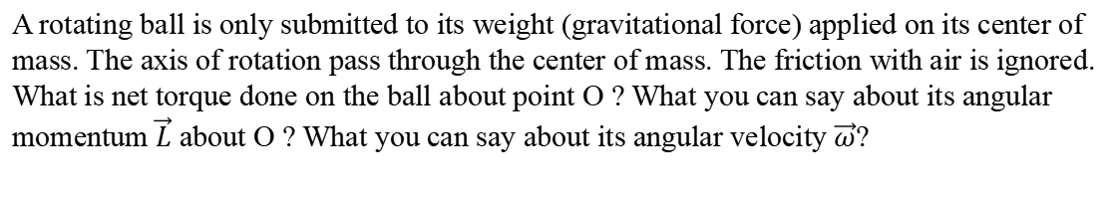

Ex. A ball only submitted to its weight (5 minutes)
O
$$+$$
$$\vec{w}$$
A rotating ball is only submitted to its weight (gravitational force) applied on its center of mass. The axis of rotation pass through the center of mass. The friction with air is ignored. What is net torque done on the ball about point O ? What you can say about its angular momentum $\vec{L}$ about O ? What you can say about its angular velocity $\vec{ω}$?
Notes:
PARLER LENTEMENT: Let’s do a little exercise, we consider a ball rotating around an axis passing through the center of mass O of the ball. The ball is only submitted to its weight. The friction with air is ignored. Please to say what is net torque done on the ball about point O. What you can say about its angular momentum $\vec{L}$ about O and about its angular velocity $\vec{ω}$?

Slide 82


Ex. A ball only submitted to its weight
O
$$+$$
$$\vec{w}$$
The only force exerted on the ball is the weight (gravitational force) applied on the center of mass (at O) of the ball.
The net torque on the ball about O is:
$$\vec{τ}=\vec{r}×\vec{w}=\vec{0}$$
because
$$\vec{r}=\vec{0}$$
Notes:
PARLER LENTEMENT: First, about the net torque exerted on the ball about O, it is the torque exerted by the gravitational force about O, but because of the gravitational force is applied at the center of mass of the ball, this torque is zero.

Slide 83
Ex. A ball only submitted to its weight
O
$$+$$
$$\vec{w}$$
The only force exerted on the ball is the weight (gravitational force) applied on the center of mass (at O) of the ball.
The net torque on the ball about O is:
$$\vec{τ}=\vec{r}×\vec{w}=\vec{0}$$
because
$$\vec{r}=\vec{0}$$
The net torque on the ball is zero
$$\vec{τ}=\vec{0}$$
its angular momentum $\vec{L}$ is constant
Notes:
PARLER LENTEMENT: And because its net torque about O is zero, its angular momentum about O stays constant.

Slide 84

Ex. A ball only submitted to its weight
O
$$+$$
$$\vec{w}$$
The only force exerted on the ball is the weight (gravitational force) applied on the center of mass (at O) of the ball.
The net torque on the ball about O is:
$$\vec{τ}=\vec{r}×\vec{w}=\vec{0}$$
because
$$\vec{r}=\vec{0}$$
The net torque on the ball is zero
$$\vec{τ}=\vec{0}$$
its angular momentum $\vec{L}$ is constant
The axis of rotation is also an axis of symmetry of the ball
$$\vec{L}=I\vec{ω}$$
Notes:
PARLER LENTEMENT: The axis of rotation is also an axis of symmetry, we deduce that the angular momentum about the center of mass is the moment of inertial of the ball about the axis of rotation multiplied by its angular velocity vector.

Slide 85





Ex. A ball only submitted to its weight
O
$$+$$
$$\vec{w}$$
The only force exerted on the ball is the weight (gravitational force) applied on the center of mass (at O) of the ball.
The net torque on the ball about O is:
$$\vec{τ}=\vec{r}×\vec{w}=\vec{0}$$
because
$$\vec{r}=\vec{0}$$
The net torque on the ball is zero
$$\vec{τ}=\vec{0}$$
its angular momentum $\vec{L}$ is constant
The axis of rotation is also an axis of symmetry of the ball
$$\vec{L}=I\vec{ω}$$
The angular velocity $\vec{ω}$is constant ! (in real situation, this is not right because there is friction with air)
Notes:
PARLER LENTEMENT: Which means that the angular velocity of the ball stays constant. Take care that is not strictly right, we obtain this result because we have ignored the friction, but there is always friction between the ball and the air.

Slide 86
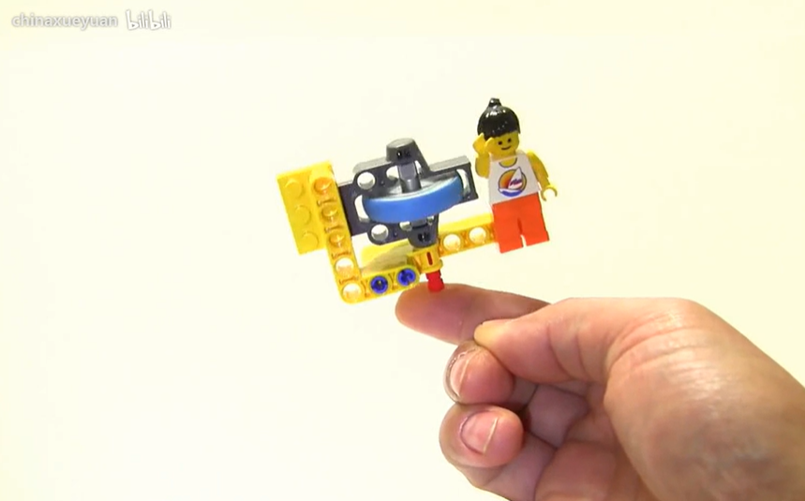

The precession phenomenon: Introduction
$$\vec{L}$$
https://www.bilibili.com/video/BV1BW411T7ur/
Notes:
PARLER LENTEMENT: To finish the description of the angular momentum, we will describe the precession phenomenom, with a flywheel toy. The blue wheel has a rotational motion around its axis. But the flywheel has another rotational motion, which means its angular momentum along its axis rotate also.

Slide 87
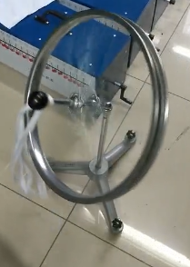

The precession phenomenon
Pivot (O)
$$\vec{L}$$
If we give an initial angular momentum to the wheel about its axis, the wheel spins around O, i.e. it has 2 rotational motions, one around its axis, and one around the pivot O.
With no initial angular momentum, the wheel is falling
Notes:
PARLER LENTEMENT: Here is another example. The wheel can be putted on a support at the pivot point O. The axis of rotation of the wheel is also axis of symmetry, the angular momentum of the wheel about point O is also the axis of the wheel. We can consider two kinds of situations. We can give or not an initial angular momentum to the wheel or not, which results in two kinds of motion. If we don’t give an initial angular momentum to the will, the wheel will simply falling. If we give an initial momentum to the wheel, when we put the wheel on the support, the wheel will have two rotational motion, one rotational motion around its axis, and one rotational motion around the pivot point O. In that case, the axis of wheel will rotate, which means its angular momentum will also rotates. This phenomenon is named the “precession” and is what we want to describe.

Slide 88
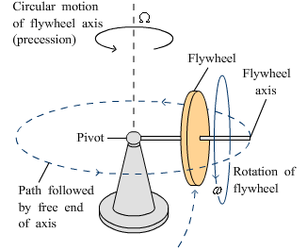
The precession phenomenon 进动现象
A flywheel spinning at angular velocity $ω$ is connected to a pivot.
The flywheel turns also around the pivot, at precession angular velocity $Ω$
This phenomenon is named precession.
Notes:
PARLER LENTEMENT: Here is another figure with a flywheel, where the both rotational motion are shown. The axis of the flywheel is putted on the pivot. If the rotation of flywheel is fast enough, the flywheel will not fall, even if the axis of the flywheel is almost horizontal. The rotational motion around the axis of the flywheel is described by the angular velocity lowercase omega. The rotational motion of the flywheel around the pivot point has angular velocity uppercase omega. This rotational motion is the precession, i.e. the rotational motion of the axis of the wheel.

Slide 89
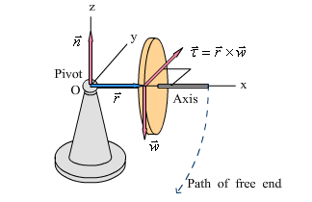
The precession phenomenon
If the flywheel is not spinning, its falls (along a circular path)
We consider the system “flywheel” (the wheel +axis)
Notes:
PARLER LENTEMENT: But first, let’s describe the motion of the wheel if we don’t give it an initial angular momentum. The consider the system flywheel corresponding to the wheel and its axis, O is at the pivot. Ox is directed along the axis of the wheel. If the wheel doesn’t spin because we don’t git it an initial angular momentum, the wheel fall along a circular path.

Slide 90

The precession phenomenon
If the flywheel is not spinning, its falls (along a circular path)
We consider the system “flywheel” (the wheel +axis)
Normal force $\vec{n}$ (applied at O):
$$no torque about the pivot (O)$$
Notes:
PARLER LENTEMENT: Let’s see what is the net torque on the will. The flywheel is putted on the support at the pivot point O. There is a normal force exerted on the flywhell applied at O, but no torque about O exerted by the normal force.

Slide 91


The precession phenomenon
If the flywheel is not spinning, its falls (along a circular path)
We consider the system “flywheel” (the wheel +axis)
Normal force $\vec{n}$ (applied at O):
$$no torque about the pivot (O)$$
Weight $\vec{w}$ (directed toward the $−z$-direction):
$$torque about the pivot (O)$$
$$\vec{τ}=\vec{r}×\vec{w}$$
where the weight is applied at the center of mass (at distance $r$ from O)
Notes:
PARLER LENTEMENT: There is also a weight exerted on the flywheel. The direction of the weight is the –z-direction. The weigh doesn’t exert a torque about the center of mass of the flywheel, but it exerts a torque about the pivot point O, which is described by position vector r and the weight w.

Slide 92
The precession phenomenon
If the flywheel is not spinning, its falls (along a circular path)
We consider the system “flywheel” (the wheel +axis)
Normal force $\vec{n}$ (applied at O):
$$no torque about the pivot (O)$$
Weight $\vec{w}$ (directed toward the $−z$-direction):
$$torque about the pivot (O)$$
$$\vec{τ}=\vec{r}×\vec{w}$$
where the weight is applied at the center of mass (at distance $r$ from O)
Net torque on the flywheel about the pivot:
$$\vec{τ}=\vec{r}×\vec{w}$$
Notes:
PARLER LENTEMENT: Thus, if we ignore friction, the net torque about O exerted on the flywheel is the torque by the weight about O.

Slide 93


The precession phenomenon
If the flywheel is not spinning initially, its falls (along a circular path)
Net torque on the flywheel:
directed in the +y-direction
$$\vec{τ}=\vec{r}×\vec{w}$$
If the wheel is not spinning initially :
$${\vec{L}}_{i}=\vec{0}$$
The change of its angular momentum during $dt$ is directed in +y direction:
$$d\vec{L}=\vec{τ}dt$$
$\left|\vec{L}\right|$ increase with the time but its direction remains the same.
Rotation around the y-axis (path of free end)
Notes:
PARLER LENTEMENT: We consider as initial time the time where we put the wheel on the support, it will have a circular notion. The initial angular momentum of the wheel about O is zero, but because of the net torque exerted on the wheel, there will be change of its angular momentum. The change of angular momentum is directed along the +y_direction because the net torque is directed along the +y-direction, as shown on the figure. The result is a rotation around the t

Slide 94

The precession phenomenon
$$z$$
$$y$$
$$\vec{τ}$$
$$x$$
If the flywheel is spinning initially
Its initial angular momentum is ${\vec{L}}_{i}≠\vec{0}$
${\vec{L}}_{i}$ is directed toward the $+$x-direction
Notes:
PARLER LENTEMENT: Now we consider that the flywheel has an initial angular momentum which is directed along the x-axis, the flywheel rotates around the x-axis.

Slide 95
The precession phenomenon
$$z$$
$$y$$
$$\vec{τ}$$
$$x$$
If the flywheel is spinning initially
Its initial angular momentum is ${\vec{L}}_{i}≠\vec{0}$
${\vec{L}}_{i}$ is directed toward the $+$x-direction
The net torque about pivot point on the flywheel is directed toward the $+y$-direction
Notes:
PARLER LENTEMENT: The net torque on the flywheel about pivot point is directed toward the +-y direction, as shown on the figure. The net torque is the torque done by the weight about pivot point because the normal force exert no torque about pivot point and the friction is ignored.

Slide 96
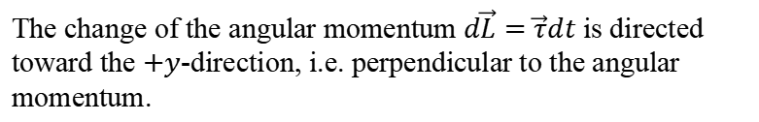
The precession phenomenon
$$z$$
$$y$$
$$\vec{τ}$$
$$x$$
If the flywheel is spinning initially
Its initial angular momentum is ${\vec{L}}_{i}≠\vec{0}$
${\vec{L}}_{i}$ is directed toward the $+$x-direction
The net torque on the flywheel is directed toward the $+y$-direction
The change of the angular momentum $d\vec{L}=\vec{τ}dt$ is directed toward the $+y$-direction, i.e. perpendicular to the angular momentum.
Notes:
PARLER LENTEMENT: So, we can describe the infinitesimal change of angular momentum which is also directed toward the +y-direction. So the change of angular momentum is perpendicular with the direction of the angular momentum.

Slide 97
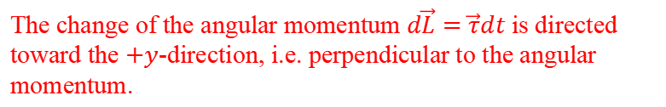




The precession phenomenon
$$z$$
$$y$$
$$\vec{τ}$$
$$y$$
$$\vec{τ}$$
$$z$$
$$⨀$$
$$d\vec{L}$$
$$x$$
$${\vec{L}}_{i}$$
$$x$$
If the flywheel is spinning initially
Its initial angular momentum is ${\vec{L}}_{i}≠\vec{0}$
${\vec{L}}_{i}$ is directed toward the $+$x-direction
The net torque on the flywheel is directed toward the $+y$-direction
The change of the angular momentum $d\vec{L}=\vec{τ}dt$ is directed toward the $+y$-direction, i.e. perpendicular to the angular momentum.
Notes:
PARLER LENTEMENT: At the right is a figure which shown the angular momentum at a time t, the net torque about pivot point and the infinitesimal change of angular momentum. Thus we can describe the angular momentum at time t+dt, it is the initial angular momentum at time t, plus its infinitesimal change.

Slide 98

The precession phenomenon
$$z$$
$$y$$
$$\vec{τ}$$
$$y$$
$$\vec{τ}$$
$${\vec{L}}_{i}+d\vec{L}$$
$$z$$
$$⨀$$
$$d\vec{L}$$
$$x$$
$${\vec{L}}_{i}$$
$$x$$
If the flywheel is spinning initially
Its initial angular momentum is ${\vec{L}}_{i}≠\vec{0}$
${\vec{L}}_{i}$ is directed toward the $+$x-direction
The net torque on the flywheel is directed toward the $+y$-direction
The change of the angular momentum $d\vec{L}=\vec{τ}dt$ is directed toward the $+y$-direction, i.e. perpendicular to the angular momentum.
Notes:
PARLER LENTEMENT: We obtain an angular momentum which has rotated around the z-axis. Its magnitude stays constant, but its direction change according to a circular motion around the z-axis.

Slide 99
The precession phenomenon
$$z$$
$$y$$
$$\vec{τ}$$
$$y$$
$$\vec{τ}$$
$${\vec{L}}_{i}+d\vec{L}$$
$$z$$
$$⨀$$
$$d\vec{L}$$
$$x$$
$${\vec{L}}_{i}$$
$$x$$
Rotation of the angular momentum around the z-axis
Precession
If the flywheel is spinning initially
Its initial angular momentum is ${\vec{L}}_{i}≠\vec{0}$
${\vec{L}}_{i}$ is directed toward the $+$x-direction
The net torque on the flywheel is directed toward the $+y$-direction
The change of the angular momentum $d\vec{L}=\vec{τ}dt$ is directed toward the $+y$-direction, i.e. perpendicular to the angular momentum.
Notes:
PARLER LENTEMENT: So, we can describe the whole rotation of the angular momentum as we did previously. This phenomenon is the precession.

Slide 100
The precession phenomenon
$$z$$
$$y$$
$$\vec{τ}$$
$$y$$
$$\vec{τ}$$
$${\vec{L}}_{i}+d\vec{L}$$
$$z$$
$$⨀$$
$$d\vec{L}$$
$$x$$
$${\vec{L}}_{i}$$
$$x$$
Rotation of the angular momentum around the z-axis
Precession
If the flywheel is spinning initially
If there was no friction, the direction of $\vec{L}$ change but not its magnitude, and the flywheel could turn around the z-axis indefinitely.
Notes:
PARLER LENTEMENT: If there was no friction, the direction of the angular momentum change, and rotates around the z-axis. However, there is always friction. What happens in that case ?

Slide 101
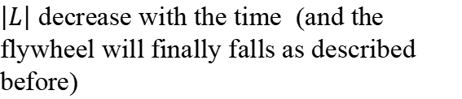
The precession phenomenon
$$z$$
$$y$$
$$\vec{τ}$$
$$y$$
$$\vec{τ}$$
$${\vec{L}}_{i}+d\vec{L}$$
$$z$$
$$⨀$$
$$d\vec{L}$$
$$x$$
$${\vec{L}}_{i}$$
$$x$$
Rotation of the angular momentum around the z-axis
Precession
If the flywheel is spinning initially
If there was no friction, the direction of $\vec{L}$ change but not its magnitude, and the flywheel could turn around the z-axis indefinitely.
But there is always friction
$\left|L\right|$ decrease with the time (and the flywheel will finally falls as described before)
Notes:
PARLER LENTEMENT: Because of the friction, the magnitude of the angular momentum will decrease, and finally the flywheel will fall, which is the same motion that what we have described when we don’t give to the flywheel an initial angular momentum.

Slide 102
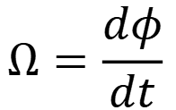


Precession angular speed 进动角速度
$$y$$
$$\vec{τ}$$
$$\vec{L}+d\vec{L}$$
$$d\vec{L}$$
$$z$$
$$⨀$$
$$dφ$$
$$x$$
The precession angular speed is the angular speed at which the angular momentum turns around the z-axis:
$$Ω=\frac{dφ}{dt}$$
Notes:
PARLER LENTEMENT: Now, lets see if we can describe the angular velocity of the rotation of the angular momentum. The rotation of the angular momentum between times t and t+dt is described by the angle d_phi,

Slide 103

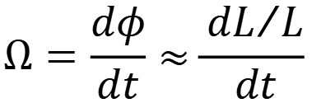
Precession angular speed
$$y$$
$$\vec{τ}$$
$$\vec{L}+d\vec{L}$$
$$d\vec{L}$$
$$z$$
$$⨀$$
$$dφ$$
$$\vec{L}$$
$$x$$
The precession angular speed is the angular speed at which the angular momentum turns around the z-axis:
$$\tan{dφ=\frac{dL}{L}≈dφ}$$
$$Ω=\frac{dφ}{dt}≈\frac{{dL}/L}{dt}$$
Notes:
PARLER LENTEMENT: As you see on the figure, the infinitesimal angle phi is the ratio between the infinitesimal change of momentum dL and the magnitude of the momentum. You see that appears the change rate of the angular momentum.

Slide 104
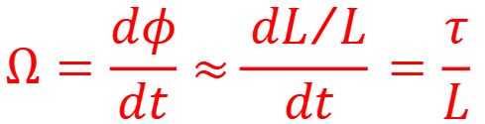
Precession angular speed
$$y$$
$$\vec{τ}$$
$$\vec{L}+d\vec{L}$$
$$d\vec{L}$$
$$z$$
$$⨀$$
$$dφ$$
$$\vec{L}$$
$$x$$
The precession angular speed is the angular speed at which the angular momentum turns around the z-axis:
Net torque on the flywheel about O
$$Ω=\frac{dφ}{dt}≈\frac{{dL}/L}{dt}=\frac{τ}{L}$$
Angular momentum of the flywheel about O
Notes:
PARLER LENTEMENT: This change rate of the angular momentum is also the net torque exerted on the flywheel about O. We obtain that the angular velocity of the rotation of the angular momentum is the net torque divided by the angular momentum.

Slide 105


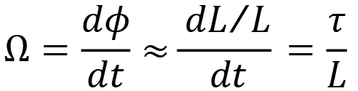
Precession angular speed
$$y$$
$$\vec{τ}$$
$$\vec{L}+d\vec{L}$$
$$d\vec{L}$$
$$z$$
$$⨀$$
$$dφ$$
$$\vec{L}$$
$$x$$
The precession angular speed is the angular speed at which the angular momentum turns around the z-axis:
Net torque on the flywheel about O
$$Ω=\frac{dφ}{dt}≈\frac{{dL}/L}{dt}=\frac{τ}{L}$$
Angular momentum of the flywheel about O
with
$$τ=\left|\vec{r}×\vec{w} \right|=rw$$
and
$$L=Iω$$
(because axis of rotation is an axis of symmetry )
Distance between O and the center of mass of the flywheel
Notes:
PARLER LENTEMENT: And we can describe the net torque as the distance r multiplied by the weight exerted on the fly wheel. The axis of rotation of the flywheel is also an axis of symmetry of the flywheel, which means its angular moment is the moment of inertia of the flywheel about its axis multiplied by it angular velocity.

Slide 106

Precession angular speed
$$z$$
$$y$$
$$\vec{τ}$$
$$x$$
with
$$τ=\left|\vec{r}×\vec{w} \right|=rw$$
and
$$L=Iω$$
(because axis of rotation is an axis of symmetry )
$$Ω=\frac{rw}{Iω}$$
You don’t need to remember this expression, but you must be able to find it by yourself.
Notes:
PARLER LENTEMENT: Thus, we obtain the corresponding angular velocity of rotation of the angular momentum of the flywheel

Slide 107
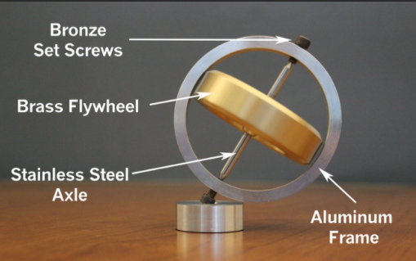
Principle of gyroscope陀螺仪原理
An example of gyroscope for demonstration.
Using of a gyroscope is based on their precession.
Gyroscopes are used (paired with accelerometer) in navigation systems of aircraft, ships, spacecraft satellites.
They measure orientation and angular velocities.
Notes:
PARLER LENTEMENT: The precession is related with the gyroscope. The using of a gyroscope is based on their precession, they are paired with an accelerometer for navigation by aircrafts, shipts, and so on. They permit to measure orientations and angular velocities.

Slide 108
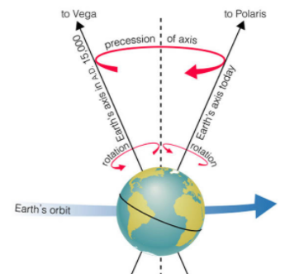
Precession of planets
Planets have precession associated with their rotational motion.
“The precession of Earth's spin axis has a profound effect on Earth's climate. Precession is involved with the approach of perihelion (the closest approach to the Sun)” [1]
[1] https://www.sciencedirect.com/topics/earth-and-planetary-sciences/precession
Notes:
PARLER LENTEMENT: The planets have also precession. The axis of rotation of a planet around itself has a precession, has shown in this figure. Precession is involved with the approach of perihelion, which is the closest approach to the sun by a planet, which is something I will describe you later in details.

Slide 109
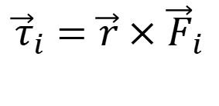
Summary
torque (by the force $\vec{F_{i}}$) of about a point O applied at distance $r$ from this point:
$${\vec{τ}}_{i}=\vec{r}×{\vec{F}}_{i}$$
Notes:
PARLER LENTEMENT: Here is a summary of the important concepts we have seen about rotation of rigid bodies. First we, have described what is a torque about a point.

Slide 110

Summary
torque (by the force $\vec{F_{i}}$) of about a point O applied at distance $r$ from this point:
$${\vec{τ}}_{i}=\vec{r}×{\vec{F}}_{i}$$
Net torque exerted on a body in rotation (at angular acceleration $\vec{α}$) around an axis, about a point O of this axis, is:
$$\vec{τ}=I\vec{α}$$
Notes:
PARLER LENTEMENT: Then we have described the rotational analogy of the Newton second law, the net torque about a point of the axis of rotation of a body is the product between the moment of inertia of the body about its axis of rotation and its angular acceleration vector.

Slide 111

Summary
torque (by the force $\vec{F}$) of about a point O applied at distance $r$ from this point:
$${\vec{τ}}_{i}=\vec{r}×{\vec{F}}_{i}$$
Net torque exerted on a body in rotation (at angular acceleration $\vec{α}$) around an axis, about a point O of this axis, is:
$$\vec{τ}=I\vec{α}$$
Angular momentum of a particle of momentum $\vec{p_{i}}$ about a point O, at distance $r$ from this point:
$$\vec{L_{i}}=\vec{r}×\vec{p_{i}}$$
Notes:
PARLER LENTEMENT: We have also described the angular momentum of a particle about a point O, it is the vector product between its position vector about point O and its linear momentum.

Slide 112


Summary
torque (by the force $\vec{F}$) of about a point O applied at distance $r$ from this point:
$${\vec{τ}}_{i}=\vec{r}×{\vec{F}}_{i}$$
Net torque exerted on a body in rotation (at angular acceleration $\vec{α}$) around an axis, about a point O of this axis, is:
$$\vec{τ}=I\vec{α}$$
Angular momentum of a particle of momentum $\vec{p_{i}}$ about a point O, at distance $r$ from this point:
$$\vec{L_{i}}=\vec{r}×\vec{p_{i}}$$
The net torque on a rigid body about a point O is the change rate of the total angular momentum about the point O:
$$\vec{τ}=\frac{d\vec{L}}{dt}$$
where
$$\vec{L}=\sum_{i}{\vec{L_{i}}}$$
Notes:
PARLER LENTEMENT: We have described that the net torque on a body about a point is the change rate of its angular momentum. This law can also be seen as a rotational analogy of the Newton second law.

Slide 113

Summary
If the axis of rotation is an axis of symmetry of the body, its angular momentum about a point O of this axis is directed toward the axis of rotation, and:
$$\vec{L}=I\vec{ω}$$
Angular velocity vector
Moment of inertia about the axis of rotation
Notes:
PARLER LENTEMENT: In the particular case where the axis of rotation is an axis of symmetry of the body, the angular momentum is the product between the moment of inertia around the axis of rotation and the angular velocity vector.

Slide 114

Summary
If the axis of rotation is an axis of symmetry of the body, its angular momentum about a point O of this axis is directed toward the axis of rotation, and:
$$\vec{L}=I\vec{ω}$$
Angular velocity vector
Moment of inertia about the axis of rotation
Total kinetic energy of a body in translational motion + rotational motion:
$$E_{k}=\frac{1}{2}Mv_{cm}^{2}+\frac{1}{2}Iω^{2}$$
Notes:
PARLER LENTEMENT: And we have also described the rotational kinetic energy. If a body has translational and rotational motion, we have to consider both translational and rotational kinetic energy. With all the analogies we have seen, if you remember the main formula about translational motion, it will be easy to remember the formula about the rotational motion.

Slide 115
End of lecture 10
Slides suivants: faire si il reste du temps, sinon, donner en homework.

